Slide 1
F#, The American Dream
DEV217
Jack Hu
F# Team, SDET Lead
Microsoft Corporation

Slide 2
Microsoft Confidential

Slide 3
Session Objectives
F# is the best programming language for solving
Computationally complex problems
Data complex problems

Slide 4
What is F#
“...a productive functional programming language for .NET that enables users to write simple code to solve complex problems.”

Slide 5

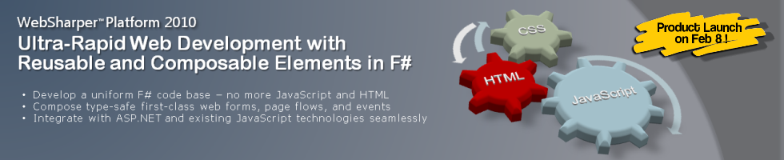

Examples of F# Usage
Amyris Biotechnologies
Biotechnology research for engineered renewable fuels
F# for in-house gene sequencing and analytics software tools
Intellifactory WebSharper Platform
Productive Web development leveraging F#
Microsoft ‘Path of Go’ Xbox Live Arcade Game
Paid Xbox Live Arcade Game
XNA with C#/F#
Leveraging advanced Go AI implemented by MSR in F#
A large European Bank
Large group using F# (150+)
Financial modeling, mission critical components

Slide 6
Two F# key Language Concepts
Let
Piping

Slide 7
The American Dream

Slide 8


Slide 9

© Fox Broadcasting Company

Slide 10

…buying a new car is the worst investment you could ever make…
- Helium.com
A new car is generally a very poor investment - ehow.com
New cars lose an average of 20 percent of their value in their first year.
- The Motley Fool

Slide 11
Auto Depreciation Model (By AAA)
Price
First year: 20%
Next 5 years: 15%
Tapers off
2012
1980
Model Year

Slide 12
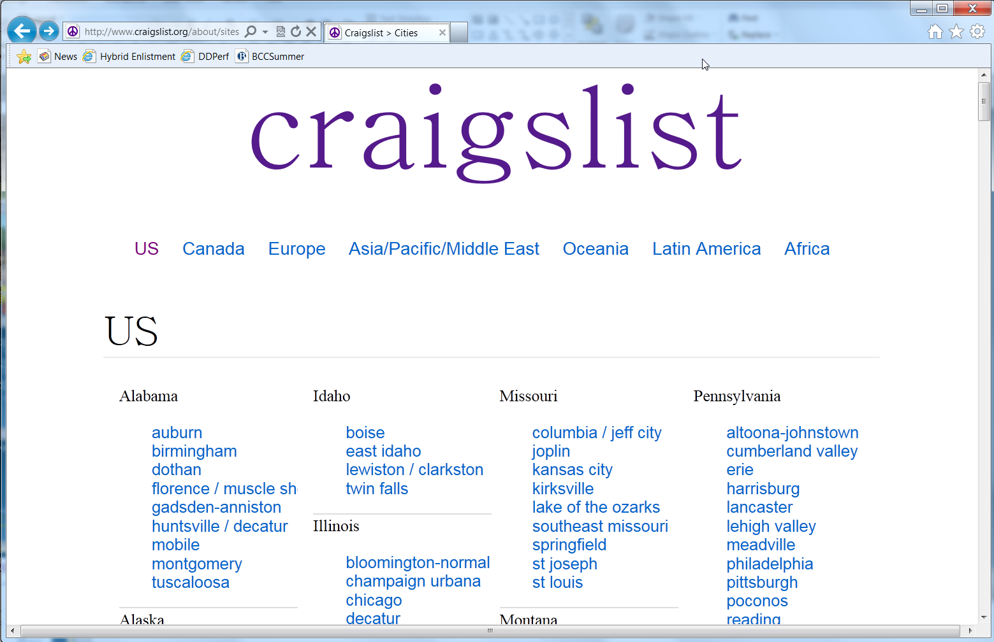

Slide 13
"(Buying used car is) going to take research if you're going to get the best value…"
Lenny Simms, vice president at NADAguides.com.

Slide 14
The Power of F#
Steps | Technologies
1. Collect CraigsList data | F# Async (2.0)
2. Store the data | EntityFramework 4.1 Code-First, SQL Express
3. Access the data | F# TypeProviders (3.0)
4. Filter the data | F# LINQ Query (3.0)
5. Computation | Linear regression, Excel formulas
6. Visualization | FSharpChart

Slide 15
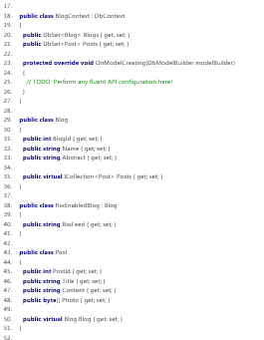
Data-First
DataBase
Code-First
DataBase

Slide 16
Craigslist Car Shopper
demo

Slide 17
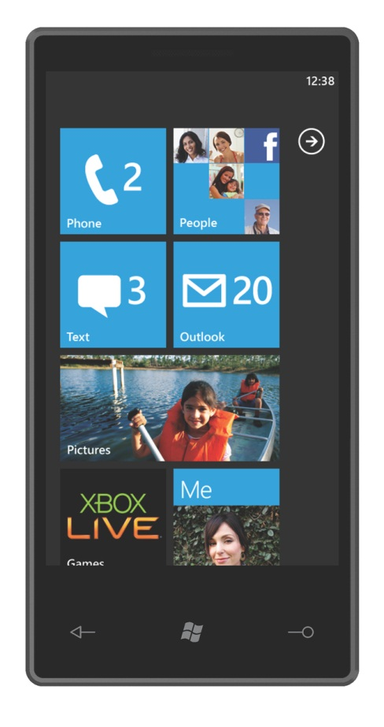
Azure,
SQL Azure

Slide 18
© Fox Broadcasting Company

Slide 19

Is this the right time to buy?

Slide 20

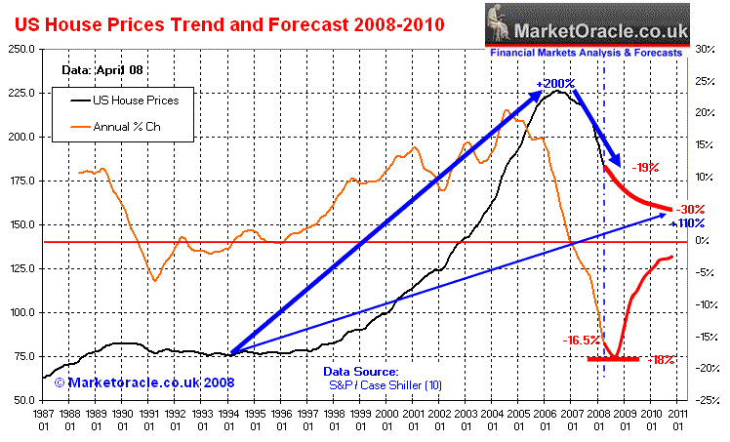
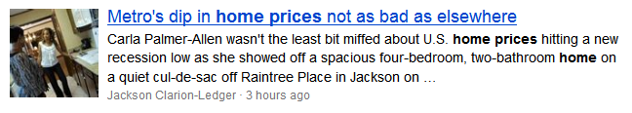
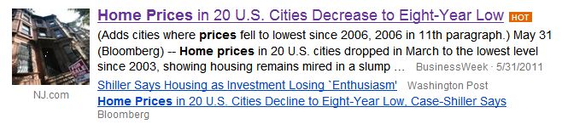
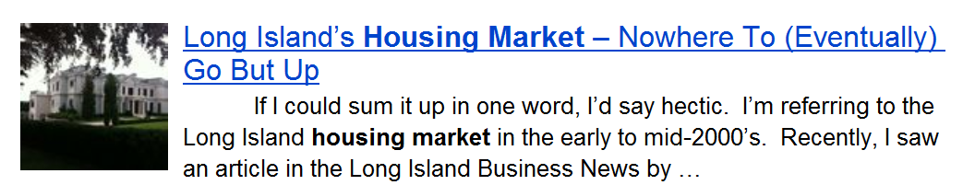
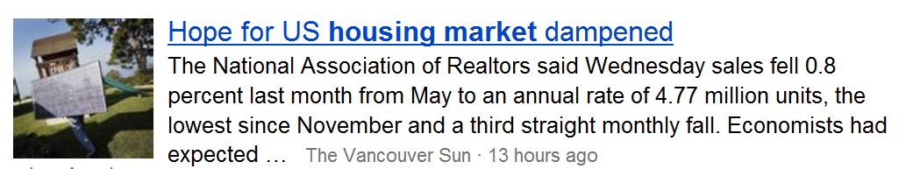

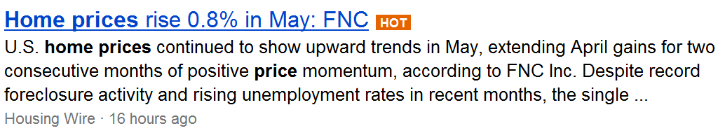

Slide 21


Slide 22
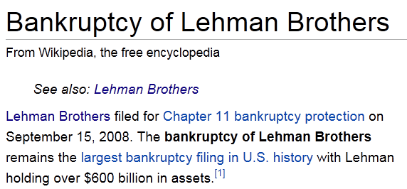
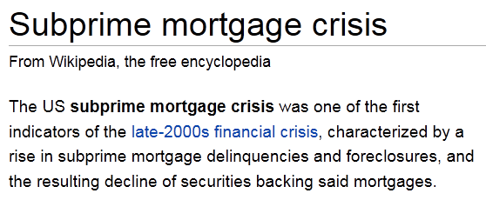
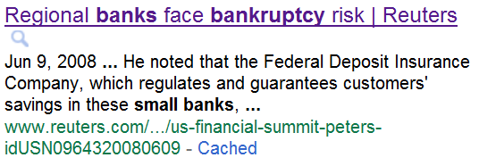
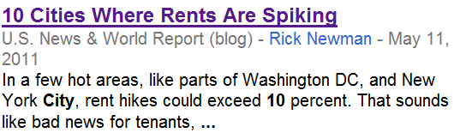
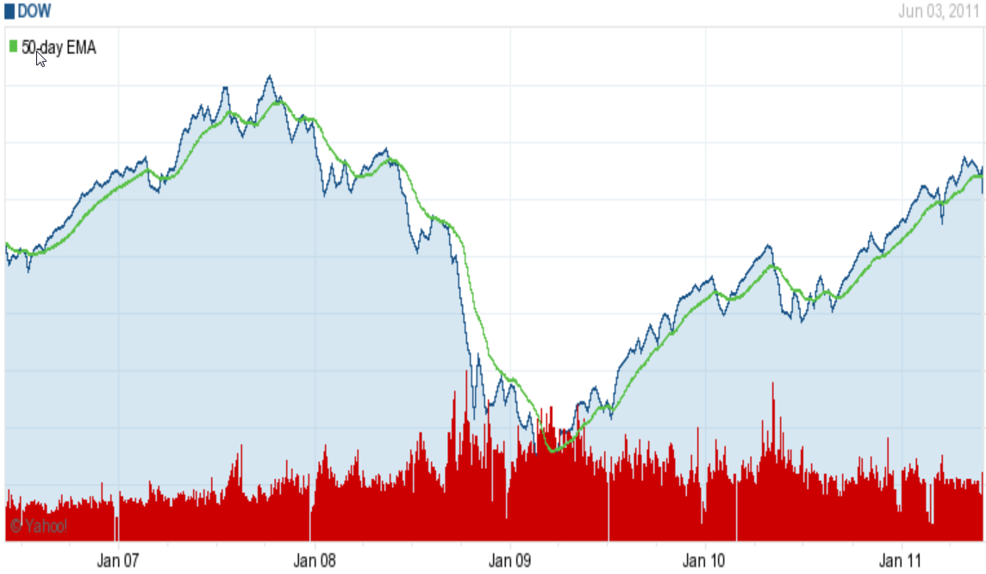
Past 5 years Dow Jones

Slide 23
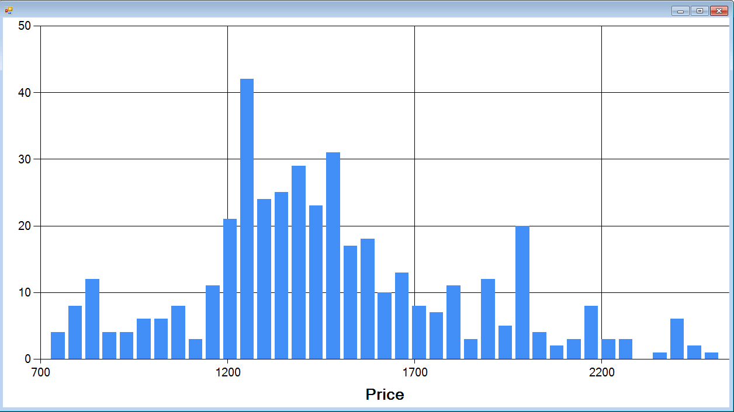
To Rent (2beds\2baths) – Redmond\Bellevue

Slide 24

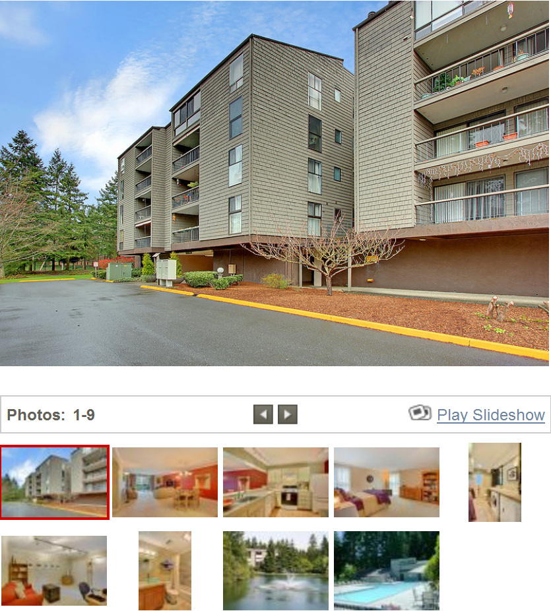
To Own (2b2b) – Redmond\Bellevue

Slide 25
The Power of F#
Steps | Technologies
1. Location, Location, Location | Azure DataMarket using TypeProviders (3.0)
2. Calculate driving distance | Bing Map API using TypeProviders (3.0)
3. Evaluate Property value | Zillow Estimator using TypeProviders(3.0)
4. Get Redfin Data | F# with Access Database
5. Get Taxes\Dues | Units of Measure, Pattern Matching (2.0)
6. Display the results | F# with Excel
7. Publish | SharePoint using TypeProviders(3.0)

Slide 26
TypeProviders
Data access platform
Intellisense helps you to browse data schemas
Provides a code centric development experience
Brings data to the developer much closer

Slide 27
Redfin House Finder
demo

Slide 28
© Fox Broadcasting Company

Slide 29

















Slide 30
Why F#?

Slide 32


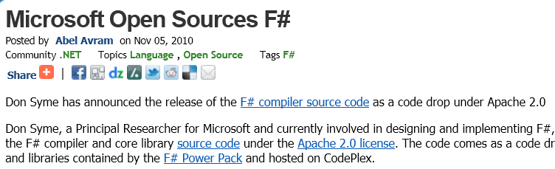
F# is Cross-Platform and Open Source

Slide 33
The best of the both worlds
Functional Language
.NET
F#
Similar core
language
Similar object
model

Slide 34
Why F#
Computationally complex problems
Succinct, Expressive, Functional, Parallel
- Productive, simple, powerful, and fun language
Data complex problems
Explorative, Data-rich
- Extends the .NET platform to important new audiences

Slide 35
F#
F is for Functional
F is for Financial
F is for Fun

Slide 36
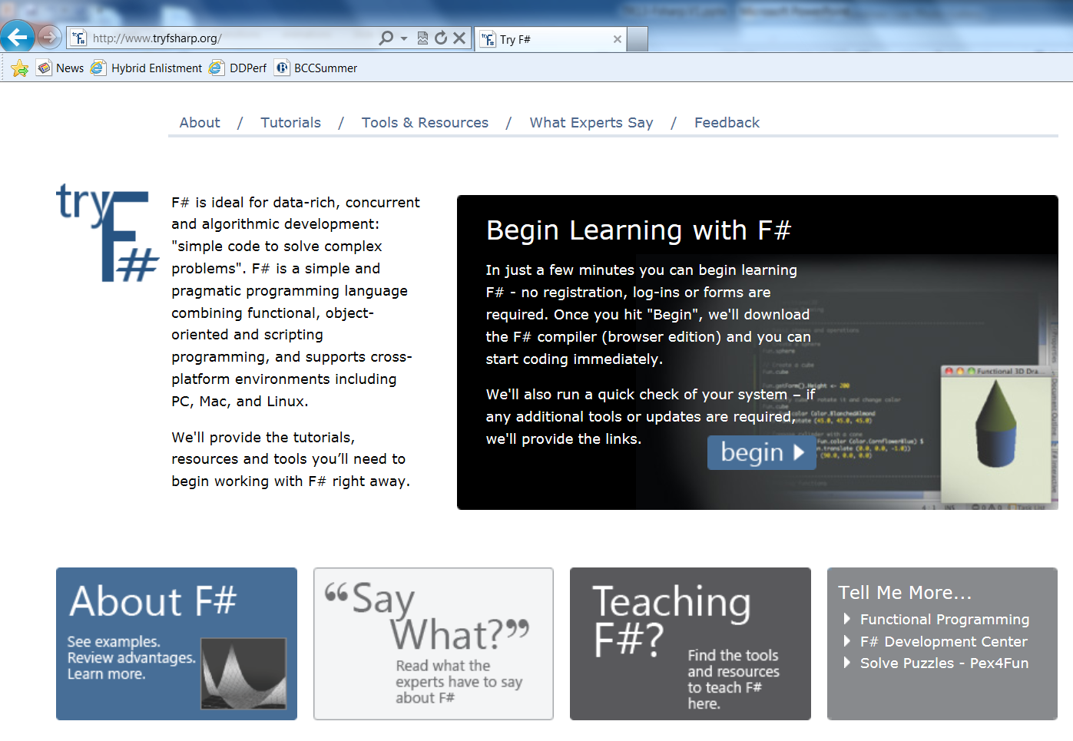
Starting Started
http://tryFsharp.org
http://fsharp.net

Slide 37


Please Complete An Evaluation Form Your input is important!
Multiple ways to access Online Evaluation Forms:
CommNet stations located throughout conference venues
Via a Windows mobile device
Via the CommNet Windows Phone 7 Evaluation and Session Scheduling application
From any wired or wireless connection to https://www.MyTechReady.com
1.
2.
3.
4.
For more information please refer to your Pocket Guide
Speaker – Click Here to Launch Video

Slide 38

© 2011 Microsoft Corporation. All rights reserved. Microsoft, Windows, Windows Vista and other product names are or may be registered trademarks and/or trademarks in the U.S. and/or other countries.
The information herein is for informational purposes only and represents the current view of Microsoft Corporation as of the date of this presentation. Because Microsoft must respond to changing market conditions, it should not be interpreted to be a commitment on the part of Microsoft, and Microsoft cannot guarantee the accuracy of any information provided after the date of this presentation. MICROSOFT MAKES NO WARRANTIES, EXPRESS, IMPLIED OR STATUTORY, AS TO THE INFORMATION IN THIS PRESENTATION.

